Slide 1

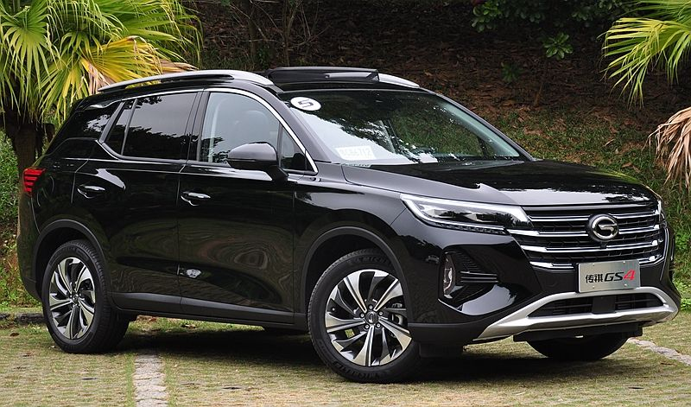
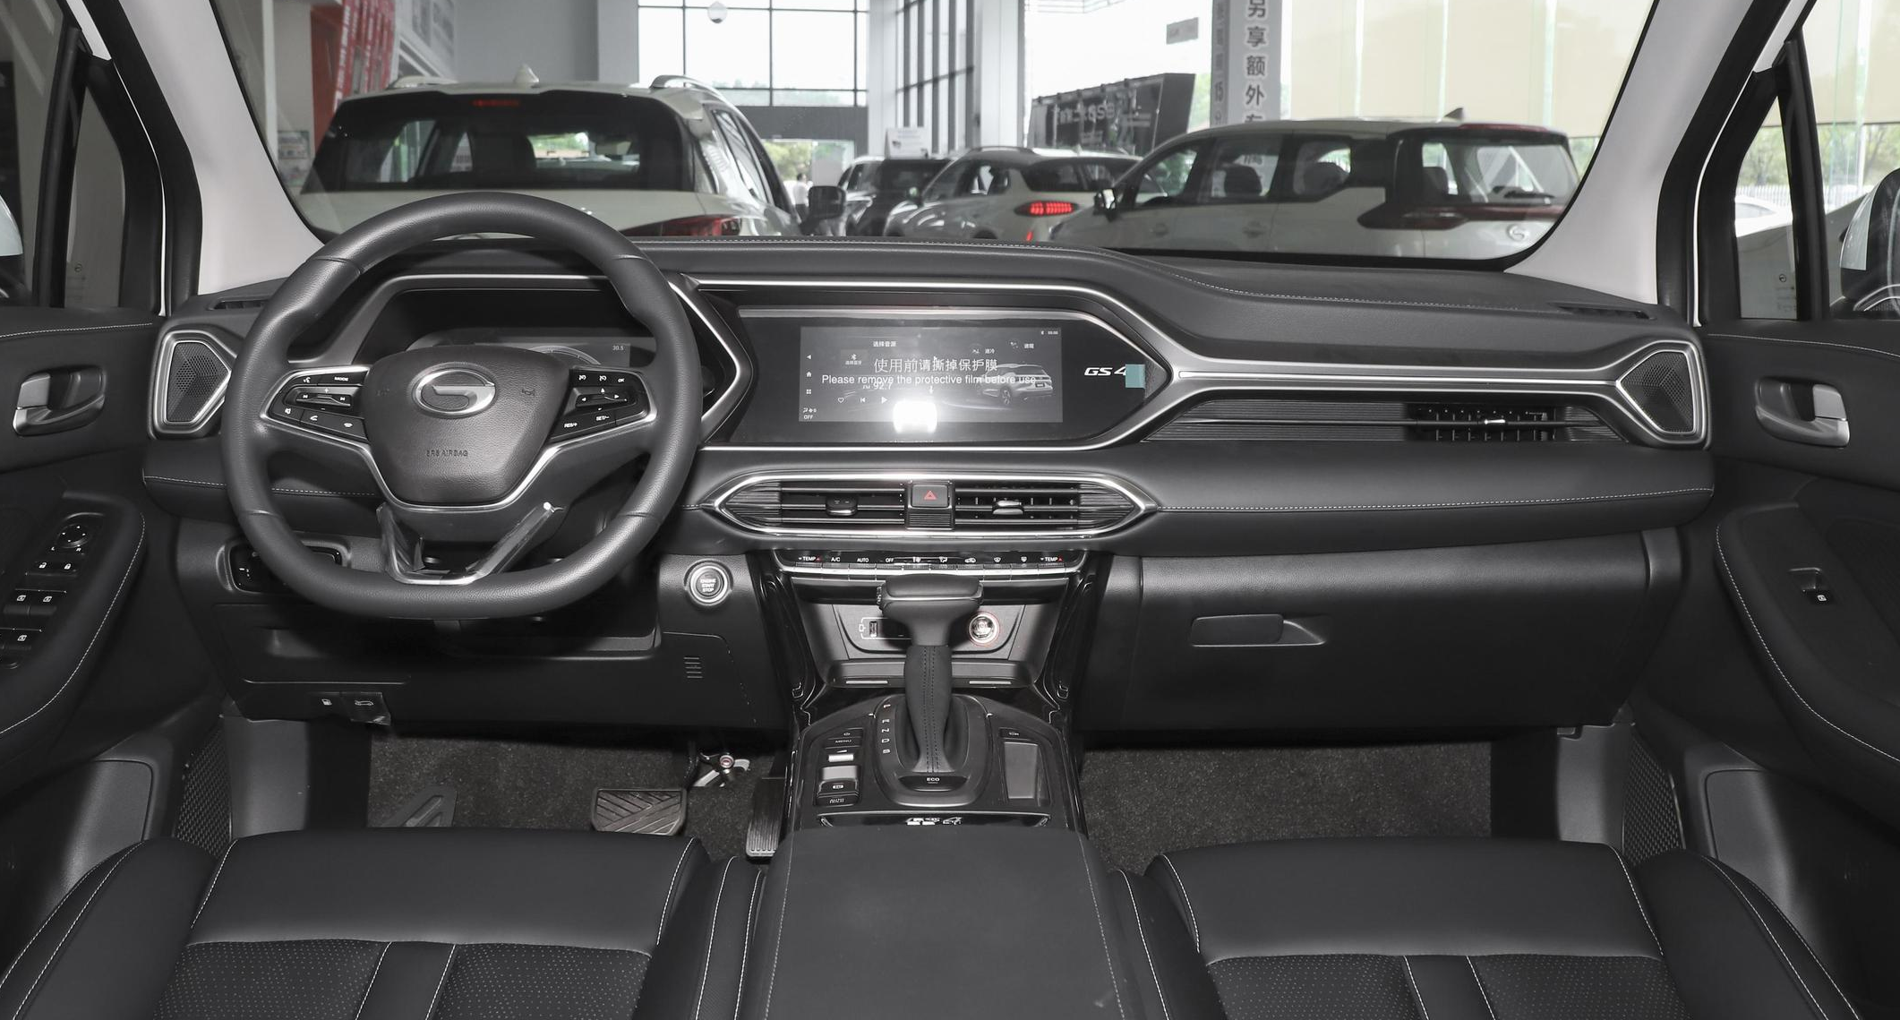
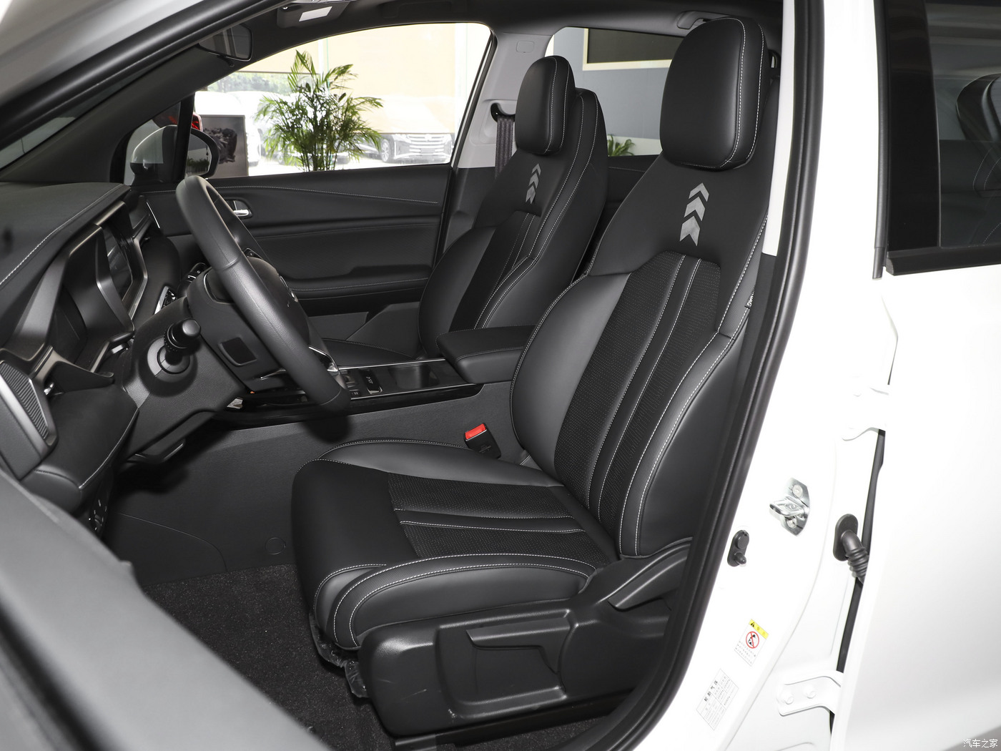
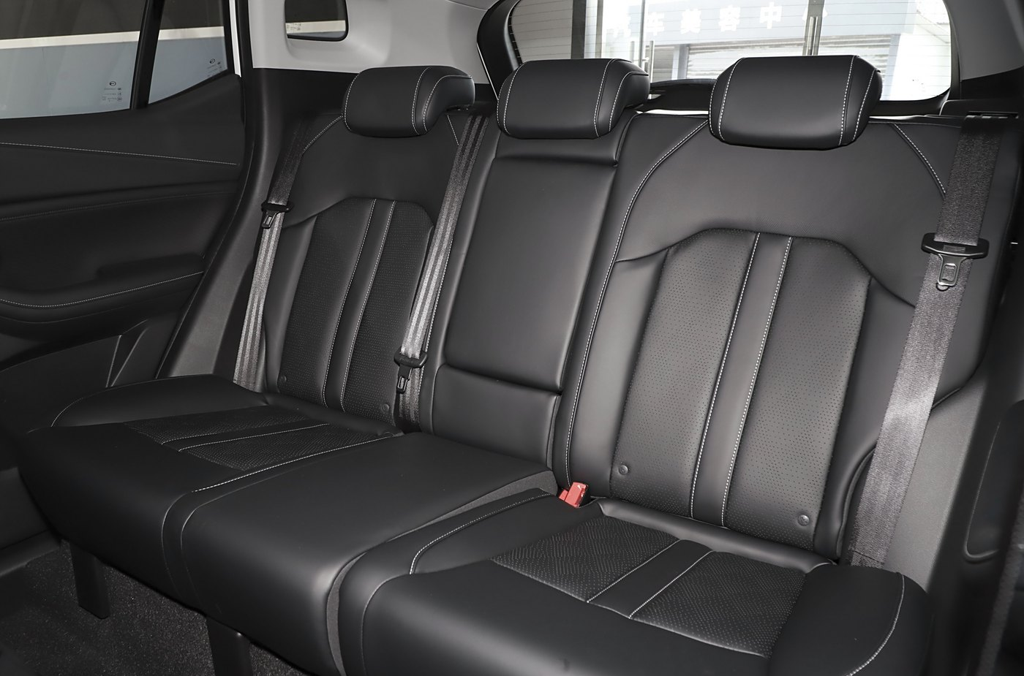
Specifications
Length
4545mm
Width
1856mm
SUV
Height
1700mm
Wheelbase
2680mm
Intelligent SUV with
Fun of Driving
Drive Type
2WD
Seating Capacity
5
Powertrain | Transmission | Max. Power (kW/rpm) | Max. Torque (Nm/rpm) | Suspension
1.5T ICE | 6AT | 124/5000 | 265/1700-4000 | Front: MacPherson Independent Suspension Rear: Multi-link Beam Independent Suspension

Slide 2
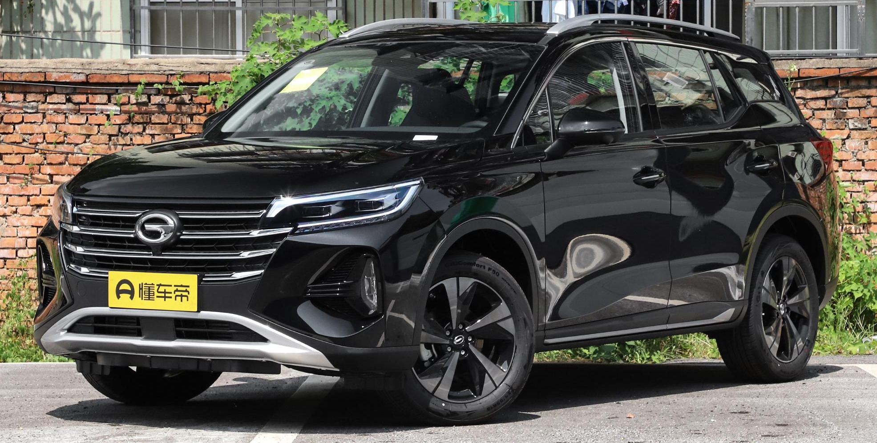
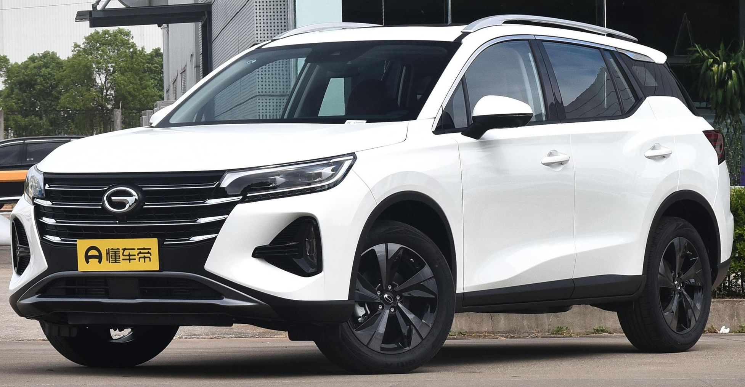
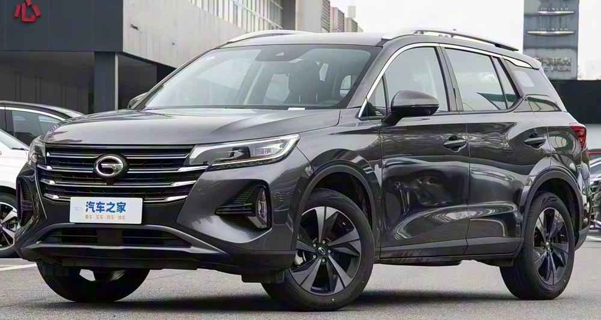
Colors & Trims
Exterior Color
Elegant Black
Ivory White
Moonlight Grey
Interior Color
Black
Trim |  | GE
Exterior Color | Interior Color | Units
Elegant Black | Black | 440
Moonlight Grey | Black | 100
Ivory White | Black | 60

Slide 3
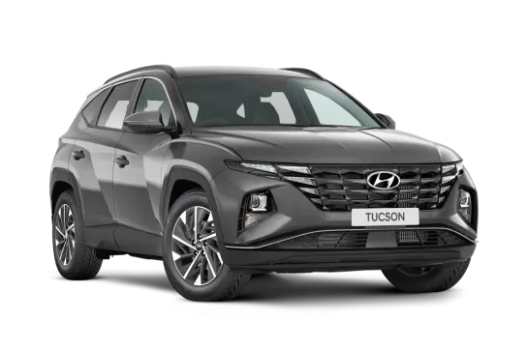
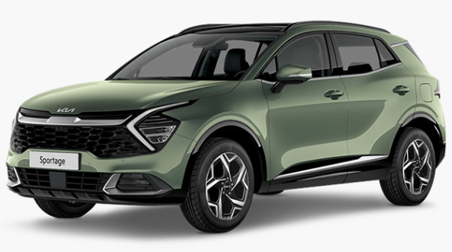
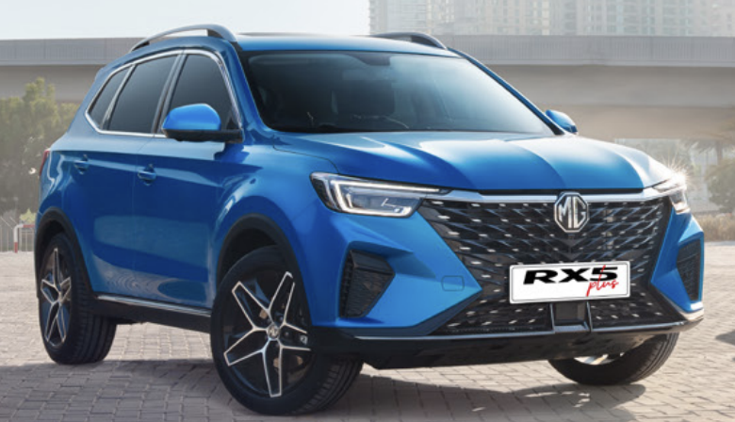
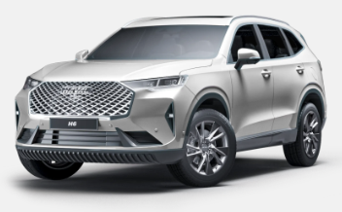
Design Concept
Competitors：
Hyundai Tucson
Kia Sportage
Forward-looking and
Innovative Design
MG RX5
Haval H6
Intelligent SUV with
Fun of Driving
China Position：C-SUV
World-leading Power
Control System
Technology of Intelligent
Interconnection

Slide 4
Specifications
车型参数及配置 | SPECIFICATIONS & FEATURES | 1.5T GDI
 |  | 6AT 两驱
 |  | GE
 |  | 高配
 |  | AT2A-JA7-00
尺寸 | DIMENSIONS
长 × 宽 × 高(mm) | Length×Width×Height (mm) | 4545x1856x1700
轴距(mm) | Wheelbase (mm) | 2680
行李厢容积(L) | Trunk Capacity (L) | 470/1560
油箱容积(L) | Fuel Tank Capacity (L) | 55
整备质量(kg) | Curb Weight (Kg) | 1500-1540
机械性能 | MECHANICAL/PERFORMANCE
主要发动机技术 | Engine Technics | E-Turbo/GCCS/DCVVT
排量(cc) | Displacement (mL) | 1495
最大功率/转速(kW/rpm) | Max. Power (kW/rpm) | 124/5000
最大扭矩/转速(N·m/rpm) | Max. Torque (N·m/rpm) | 265/1700-4000
变速箱形式 | Transmission | 6AT
综合工况油耗(km/L) | Fuel Consumption Under Comprehensive Road Conditions (km/L) | 16.1
悬挂系统 | Suspension | Front: McPherson Type Independent Suspension Rear: Multi-link Beam Independent Suspension
制动系统 | Brakes | Front: Ventilated Disc Brakes / Rear: Disc Brakes
转向系统 | Steering | Electric Power Steering (EPS)
鲨鱼鳍天线 | Shark Fin Antenna | ●

Slide 5
Specifications
车型参数及配置 | SPECIFICATIONS & FEATURES | 1.5T GDI
 |  | 6AT 两驱
 |  | GE
 |  | 高配
 |  | AT2A-JA7-00
外观 | EXTERIOR
18寸铝合金轮胎 | 18" Aluminum Alloy Wheels+215/55 Tires | ●
T型备胎 | Temporary Spare Wheel | ●
LED前大灯 | LED Headlights | ●
前大灯未关警告/前大灯延时关闭 | Alarm for Headlights On/ Follow Me Home Function | ●
自动大灯 | Auto Headlights | ●
LED日间行车灯 | LED Daytime Running Lights (DRL) | ●
LED高位刹车灯 | LED High Mounted Brake Light | ●
后雾灯 | Rear Fog Lights | ●
外后视镜电动调节 | Power Adjustable Side Mirrors | ●
外后视镜除雾、除霜功能 | Heated Side Mirrors | ●
外后视镜自动折叠 | Automatic Folding Side Mirrors | ●

Slide 6
Specifications
车型参数及配置 | SPECIFICATIONS & FEATURES | 1.5T GDI
 |  | 6AT 两驱
 |  | GE
 |  | 高配
 |  | AT2A-JA7-00
内饰 | INTERIOR
深色内饰（黑色） | Dark Interior (Black ) | ●
双区自动空调 | Dual-zone Automatic Air Conditioning | ●
AQS空气质量传感器 | Air Quality system | ●
真皮包覆方向盘 | Leather-trimmed Steering Wheel | ●
多功能方向盘 | Multi-functional Steering Wheel | ●
皮质座椅 | Leatherette-trimmed Seats | ●
驾驶员座椅6向电动调节 | 6-way Power Adjustable Driver's Seat | ●
前乘客座椅4向手动调节 | 4-way Manual Adjustable Front Passenger's Seat | ●
主驾一键升降（防夹） | Driver's Window One-touch Up & Down (Anti-pinch) | ●
后排中央头枕 | Second Row Center Armrest & Seat Headrest | ●
后排空调出风口 | Second Row A/C Vents | ●
后排靠背按比例放倒（6/4）座垫翻折 | 60:40 Split and Reclining Second Row Seats | ●
电动天窗 | Power Sunroof | ●
鲨鱼鳍天线 | Shark Fin Antenna | ●

Slide 7
Specifications
车型参数及配置 | SPECIFICATIONS & FEATURES | 1.5T GDI
 |  | 6AT 两驱
 |  | GE
 |  | 高配
 |  | AT2A-JA7-00
安全 | SAFETY
驾驶员和乘员安全气囊 | Dual Front Airbags | ●
前排侧气囊 | Front Side Airbags | ●
前排单预紧限力式安全带 | Front Row Seats Seatbelts w/ Pretensioners and Force Limiters | ●
前排安全带未系灯光提示及未系声响报警 | Front Seat Seatbelt Untied Alarm (Light and Chime) | ●
后排未系提示 | Rear Passenger's Seat Seatbelt Untied Alarm (Light) | ●
制动防抱死系统 | Anti-lock Braking System (ABS) | ●
电子制动力分配系统 | Electric Brakeforce Distribution (EBD) | ●
车辆电子稳定控制系统 | Electronic Stability Program (ESP) | ●
HBA液压制动辅助 | Hydraulic Brake Assist (HBA) | ●
上坡辅助控制系统（HHC） | Hill-start Hold Control (HHC) | ●
下坡辅助控制系统（HDC） | Hill Descent Control (HDC) | ●
EPB+Auto-hold | Electronic Parking Brake (EPB) w/ Autohold | ●
胎压监测 | Tire Pressure Monitoring System (TPMS) | ●
ISOFix | ISOFix Child Safety Seat Anchors | ●
后排侧门儿童锁 | Second Row Child Safety Door Lock | ●
发动机防盗 | Engine Immobilizer (w/ Anti-theft Alarm) | ●

Slide 8
Specifications
车型参数及配置 | SPECIFICATIONS & FEATURES | 1.5T GDI
 |  | 6AT 两驱
 |  | GE
 |  | 高配
 |  | AT2A-JA7-00
科技娱乐 | ENTERTAINMENT & TECHNOLOGY
AM/FM | AM/FM | ●
手机互联 | Phone Mirroring | ●
导航 | Navigation | ●
12.3英寸触控中控屏（英语+阿拉伯语） | 12.3-in. Color Touch Screen Display | ●
12.3吋液晶仪表 | 12.3-in. LCD Instrument Panel | ●
手机无线充电 | Wireless Phone Charging | ●
6扬声器 | 6 Speakers | ●
USB充电口（可读MP3/WMA数据） | USB Port （MP3/WMA） | ●
蓝牙系统 | Bluetooth® Handsfree Phone System | ●
音响音量随车速调节 | Speed Based Volume Adjustment | ●
巡航系统 | Cruise Control | ●
无匙启动/智能进入 | PEPS (Passive Entry Passive Start) | ●
倒车雷达 | Parking Sensors | ●
360全景影像 | Surround View Parking System | ●
节能模式 | ECO Mode | ●
1. “●”-Standard（由此装备）；“○”-Optional（选装）;“━”-N/A（无此装备）. 2. 在某些国家或地区，某些选项可能不适用。 具体的规格参数以实车为准， 并请咨询GAC Motor授权的经销商。 Some options may not be available in some countries or regions. The specifications are subject to the actual vehicle. Please consult the authorized dealer for availability 3. GAC Motor保留对该配置表内容的所有权利 All rights reserved by GAC MOTOR

